Slide 1


Basic AI
for
Everyone
Prof. Kenneth K.M. Lam
Centre for Advances in Reliability and Safety
(www.cairs.hk)
Department of EEE, HK PolyU
Email: enkmlam@polyu.edu.hk

Slide 2
Part A (55 minutes)
Learning Systems
Learning: Supervised and Unsupervised
Classification and Detection: Features
Neuron and Perceptron
Correlation/Dot Product
Perceptron Algorithm
Multilayer Neural Network
Deep Neural Network:
Convolutional Neural Network (CNN)

Slide 3
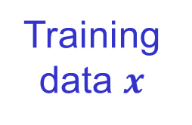
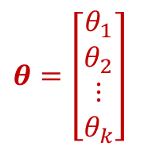
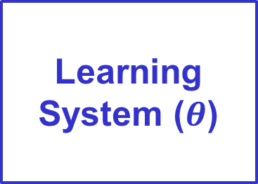
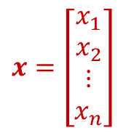

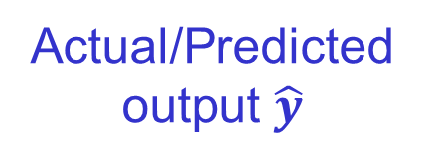
Learning Systems
The learning of a machine is based on three parts:
  The data to be learned by a method
  A metric that quantifies the error between the output and the idea output
  A feedback mechanism that uses the quantified error to guide the method to produce better results (backpropagation algorithm)
Learning System ($θ$)
Actual/Predicted output $\hat{y}$
Training data $x$
$$ℒ(\hat{y},y)$$
$$x=\left[\begin{matrix}\begin{matrix}x_{1} \\ x_{2}\end{matrix} \\ ⋮ \\ x_{n}\end{matrix}\right]$$
$$θ=\left[\begin{matrix}\begin{matrix}θ_{1} \\ θ_{2}\end{matrix} \\ ⋮ \\ θ_{k}\end{matrix}\right]$$
Loss function
Ground-Truth/
Expected output
Parameters

Slide 4
Learning:
Supervised and Unsupervised
Types of Learning
Machine Learning (ML) algorithms are broadly classified into three types:
  Supervised learning
  Unsupervised learning
  Reinforcement learning
Supervised Learning
  The data used for is labeled, i.e., the data has been divided into different classes
  Examples: algorithms for image classification, object detection, face recognition, etc.

Slide 5
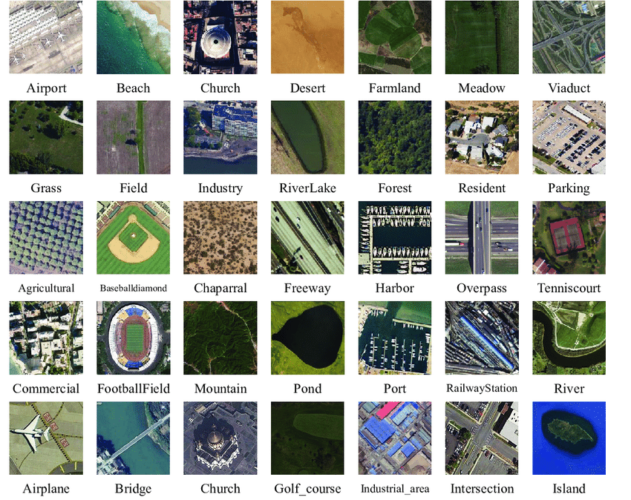
Classification and Detection:
Features
Object Detection
Classification
Bounding box
  Image annotation or labeling is a tedious and labor-intensive process
  For training an algorithm, hundreds of thousands of training samples are needed

Slide 6
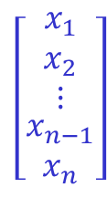

Classification and Detection:
Features
Image Classification and Object Detection
To perform classification and detection on an image, the pixel values will not be used directly
Features (also called descriptors, meta-data, etc.) are extracted from the image
Based on the features, classification or detection is performed by a classifier
Feature Extraction
$$\left[\begin{matrix}x_{1} \\ x_{2} \\ \begin{matrix}⋮ \\ \begin{matrix}x_{n−1} \\ x_{n}\end{matrix}\end{matrix}\end{matrix}\right]$$
Classifier
Output
an $n$-D
feature vector

Slide 7
Classification and Detection:
Features
Two types of features:
  Handcrafted features: designed and created by humans based on their knowledge and experience
  Examples: histogram of oriented gradients (HOG), local binary pattern (LBP), scale-invariant feature transform (SIFT), Gabor wavelets, ….
  Deep features: learned by using a deep neural network with a huge amount of training samples
The features need to be robust to or invariant to translation, scale, orientation, lighting conditions, etc.
Classifiers: k-nearest neighbor (KNN), Support Vector Machine (SVM), Random Forest, …

Slide 8
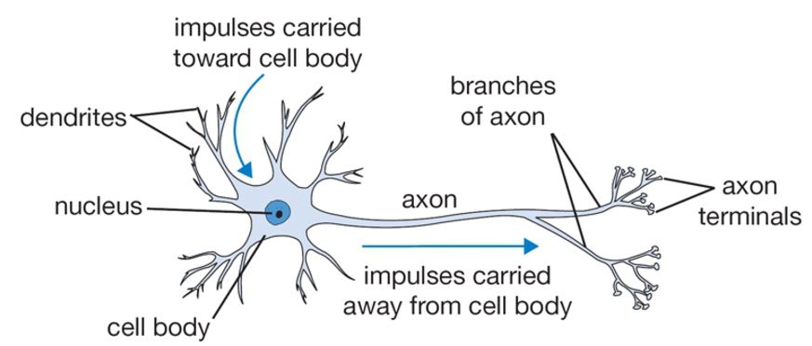




Neuron and Perceptron
A biological neuron
(synapse)
weights
weighted sum of the input signals
$$w_{1}$$
.
.
.
.
$$w_{2}$$
output signal
input signals
$$f(net)$$
activation function
An artificial neuron
$$w_{n}$$

Slide 9
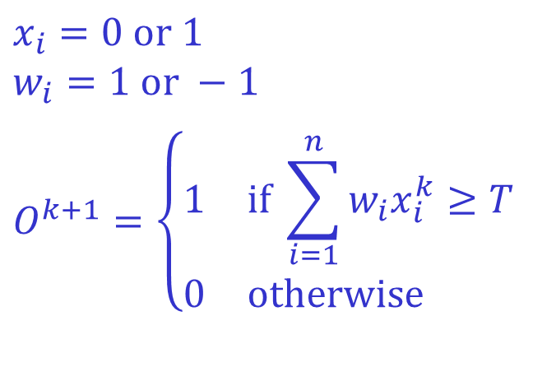
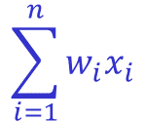





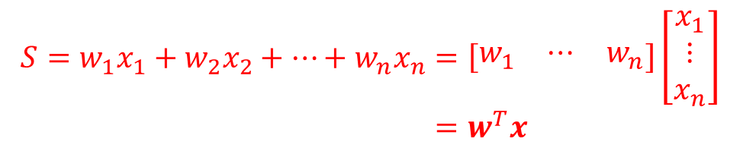
Neuron and Perceptron
Early 1940s, McCulloch and Pitts
  Proposed neuron models in the form of binary thresholding devices
  Can perform the basic logic operations (NOT, OR and AND)
$$S=w_{1}x_{1}+w_{2}x_{2}+…+w_{n}x_{n}=\left[\begin{matrix}w_{1} & ⋯ & w_{n}\end{matrix}\right]\left[\begin{matrix}x_{1} \\ ⋮ \\ x_{n}\end{matrix}\right]$$
$$=w^{T}x$$
input
weights
$$x_{1}$$
$$x_{2}$$
$$x_{n−1}$$
$$x_{n}$$
$$x_{i}=0 or 1$$
$$w_{i}=1 or −1$$
$$O^{k+1}=\left\{\begin{matrix}1 & if \sum_{i=1}^{n}{w_{i}x_{i}^{k}}≥T \\ 0 & otherwise \end{matrix}\right.$$
$$w_{1}$$
a threshold
$$w_{2}$$
⋅⋅⋅⋅
$$\sum_{i=1}^{n}{w_{i}x_{i}}$$
+1
output
+1 or 0
$$w_{n−1}$$
0
$$w_{n}$$

Slide 10

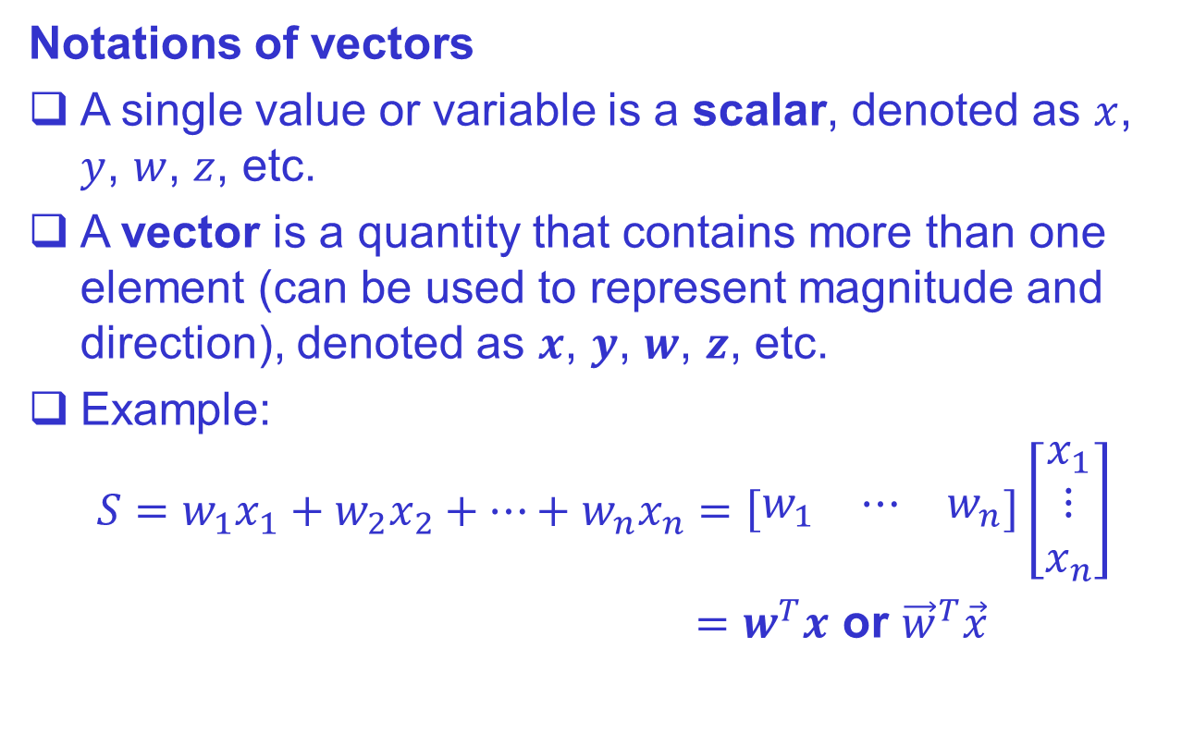
Correlation/Dot Product
Notations of vectors
A single value or variable is a scalar, denoted as $x$, $y$, $w$, $z$, etc.
A vector is a quantity that contains more than one element (can be used to represent magnitude and direction), denoted as $x$, $y$, $w$, $z$, etc.
Example:
$$S=w_{1}x_{1}+w_{2}x_{2}+…+w_{n}x_{n}=\left[\begin{matrix}w_{1} & ⋯ & w_{n}\end{matrix}\right]\left[\begin{matrix}x_{1} \\ ⋮ \\ x_{n}\end{matrix}\right]$$
$=w^{T}x$ or ${\vec{w}}^{T}\vec{x}$
A column vector
A row vector
where $w=\left[\begin{matrix}w_{1} \\ ⋮ \\ w_{n}\end{matrix}\right], x=\left[\begin{matrix}x_{1} \\ ⋮ \\ x_{n}\end{matrix}\right]$

Slide 11
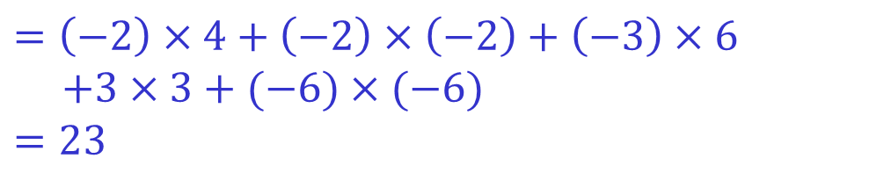
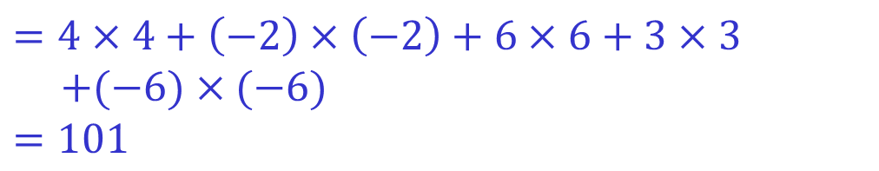
Dot product / Correlation
$$=4×4+\left(−2\right)×\left(−2\right)+6×6+3×3$$
$$+(−6)×(−6)$$
$$=101$$
4 -2 6 3 -6
The two sequences are the same
4 -2 6 3 -6
$$=\left(−2\right)×4+\left(−2\right)×\left(−2\right)+\left(−3\right)×6$$
$$+3×3+(−6)×(−6)$$
$$=23$$
-2 -2 -3 3 -6
The two sequences are not the same
4 -2 6 3 -6

Slide 12
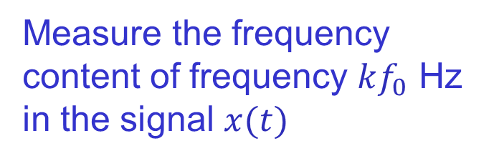
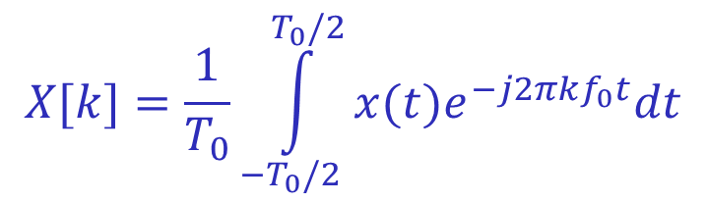

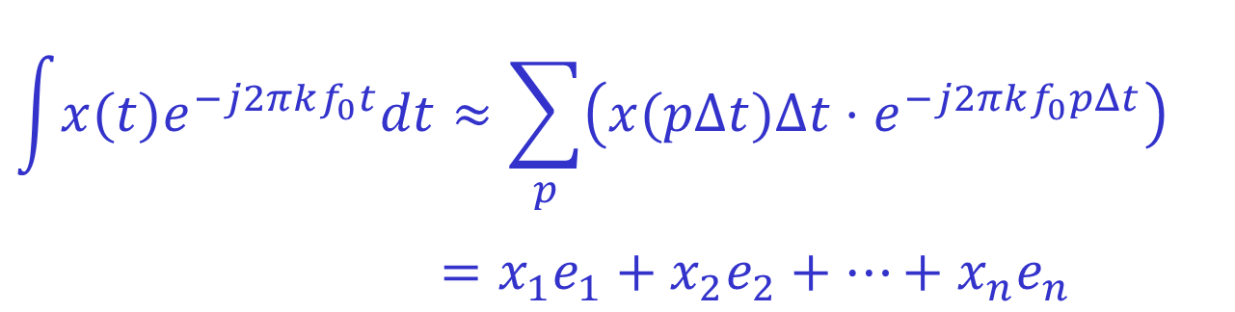
Correlation/Dot Product
The dot-product operation is to measure the similarity between two functions or sequences
$$\int{x(t)e^{−j2πkf_{0}t}dt}≈\sum_{p}{\left(x(pΔt)Δt⋅e^{−j2πkf_{0}pΔt}\right)}$$
$$=x_{1}e_{1}+x_{2}e_{2}+…+x_{n}e_{n}$$
signal
kernel or basis function
$$\cos\left(2πkf_{0}t\right)+j\sin\left(2πkf_{0}t\right)$$
$$X[k]=\frac{1}{T_{0}}\int_{−T_{0}/2}^{T_{0}/2}{x(t)e^{−j2πkf_{0}t}dt}$$
Measure the frequency content of frequency $kf_{0}$ Hz in the signal $x(t)$

Slide 13




Perceptron Algorithm
Mid-1950s – early 1960s, Rosenblatt
  Perceptrons, when trained with linearly separable training sets, would converge to a solution in a finite number of iterative steps
  The basic perceptron networks were inadequate for most pattern recognition tasks
  Multiple layers of perceptrons – lacked effective training algorithms
$$x2$$
$$x2$$
linearly separable
$$x1$$
$$x1$$

Slide 14
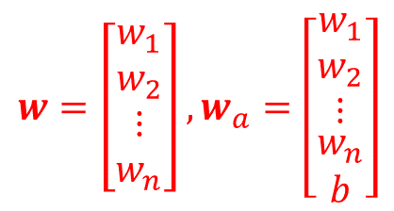
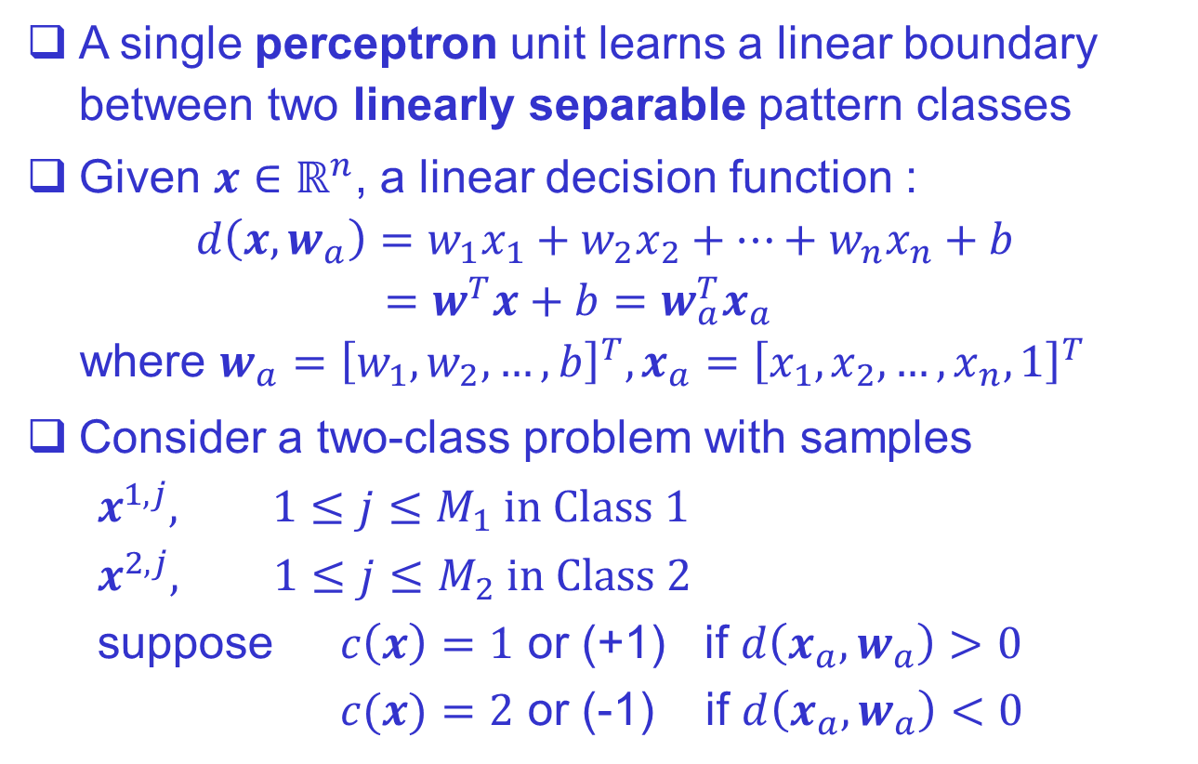




Perceptron Algorithm
$$w=\left[\begin{matrix}\begin{matrix}w_{1} \\ w_{2}\end{matrix} \\ \begin{matrix}⋮ \\ w_{n}\end{matrix}\end{matrix}\right], w_{a}=\left[\begin{matrix}\begin{matrix}w_{1} \\ w_{2}\end{matrix} \\ \begin{matrix}⋮ \\ \begin{matrix}w_{n} \\ b\end{matrix}\end{matrix}\end{matrix}\right]$$
$x$ is a $n$-D vector
A single perceptron unit learns a linear boundary between two linearly separable pattern classes
Given $x∈ℝ^{n}$, a linear decision function :
$d\left(x,w_{a}\right)=w_{1}x_{1}+w_{2}x_{2}+…+w_{n}x_{n}+b$
$$=w^{T}x+b=w_{a}^{T}x_{a}$$
where $w_{a}={\left[{w_{1},w}_{2},…,b\right]}^{T},x_{a}={\left[{x_{1},x}_{2},…,x_{n}, 1\right]}^{T}$
Consider a two-class problem with samples
$$x^{1,j}, 1≤j≤M_{1} in Class 1$$
$$x^{2,j}, 1≤j≤M_{2} in Class 2$$
suppose $c\left(x\right)=1$ or (+1) if $d\left(x_{a},w_{a}\right)>0$ $c(x)=2$ or (-1) if $d\left(x_{a},w_{a}\right)<0$
bias, bias coefficient, bias weight
Augmented weight vector
dot product
$$x_{2}$$
$$x_{1}$$
$$w_{1}x_{1}+w_{2}x_{2}+b=0$$
line
plane
hyperplane

Slide 15
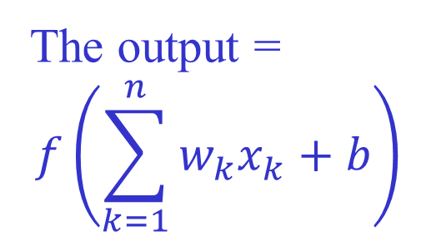
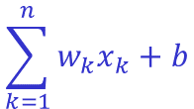

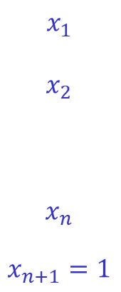



Perceptron Algorithm
$$x_{1}$$
$$x_{2}$$
$$x_{n}$$
$$x_{n+1}=1$$
$$w_{1}$$
The output =
$$f\left(\sum_{k=1}^{n}{w_{k}x_{k}+b}\right)$$
$$w_{2}$$
⋅⋅⋅⋅
+1
$$\sum_{k=1}^{n}{w_{k}x_{k}+b}$$
+1 or -1
$$w_{n}$$
-1
$$w_{n+1}=b$$
activation function
The activation function is a thresholding function
The perceptron attempts to find a solution by iteratively stepping through the patterns of each of two classes
Starting with an arbitrary weight vector and bias, the perceptron is guaranteed to converge in a finite number of iterations if the classes are linearly separable
Slide 22

Slide 16
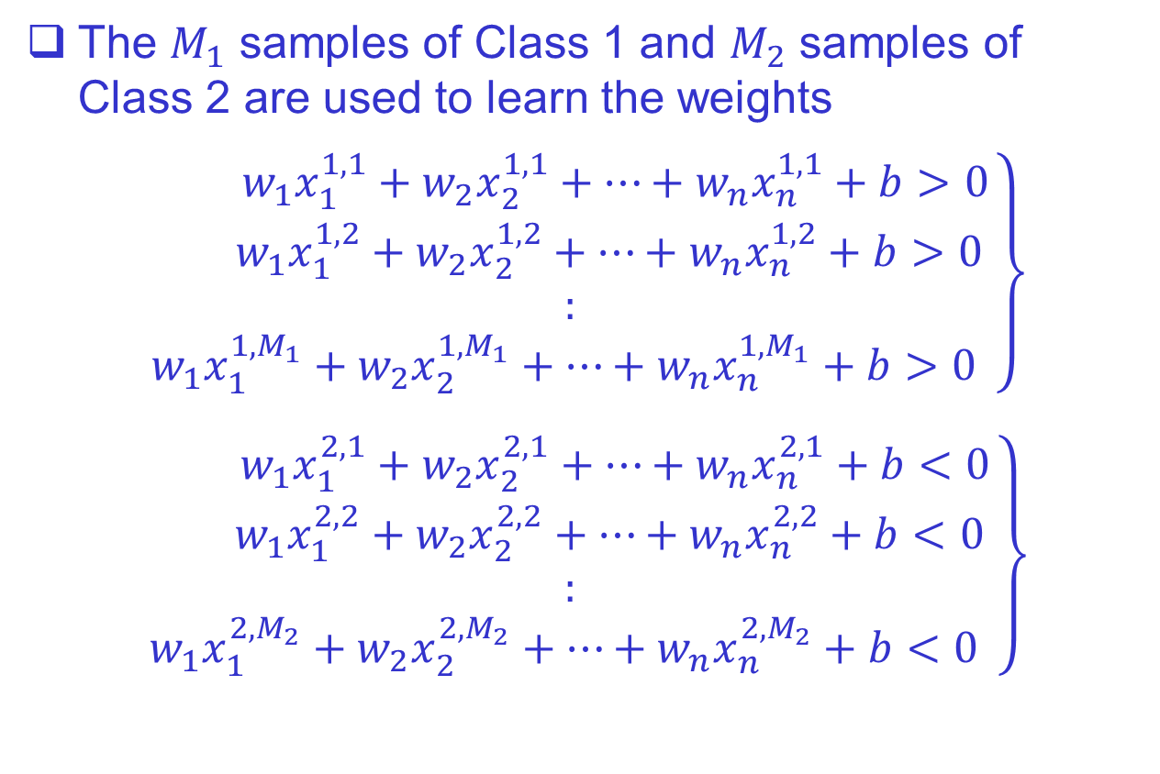
Perceptron Algorithm
The $M_{1}$ samples of Class 1 and $M_{2}$ samples of Class 2 are used to learn the weights
$$\left.\begin{aligned} w_{1}x_{1}^{1,1}+w_{2}x_{2}^{1,1}+…+w_{n}x_{n}^{1,1}+b>0 \\ { w}_{1}x_{1}^{1,2}+w_{2}x_{2}^{1,2}+…+w_{n}x_{n}^{1,2}+b>0 \\ : \\ w_{1}x_{1}^{1,M_{1}}+w_{2}x_{2}^{1,M_{1}}+…+w_{n}x_{n}^{1,M_{1}}+b>0 \end{aligned}\right\}$$
$$\left.\begin{aligned} w_{1}x_{1}^{2,1}+w_{2}x_{2}^{2,1}+…+w_{n}x_{n}^{2,1}+b<0 \\ { w}_{1}x_{1}^{2,2}+w_{2}x_{2}^{2,2}+…+w_{n}x_{n}^{2,2}+b<0 \\ : \\ w_{1}x_{1}^{2,M_{2}}+w_{2}x_{2}^{2,M_{2}}+…+w_{n}x_{n}^{2,M_{2}}+b<0 \end{aligned}\right\}$$

Slide 17

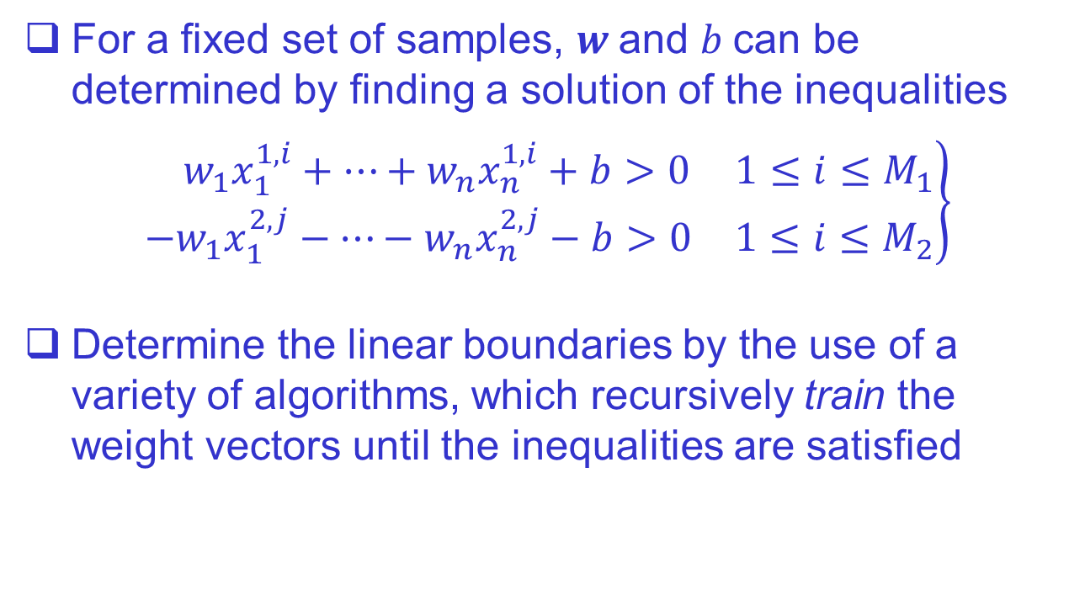
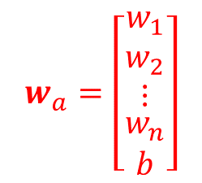
Perceptron Algorithm
For a fixed set of samples, $w$and $b$can be determined by finding a solution of the inequalities
$$\left.\begin{matrix} w_{1}x_{1}^{1,i}+…+w_{n}x_{n}^{1,i}+b>0 & 1≤i≤M_{1} \\ {−w}_{1}x_{1}^{2,j}−…−w_{n}x_{n}^{2,j}−b>0 & 1≤i≤M_{2}\end{matrix}\right\}$$
Determine the linear boundaries by the use of a variety of algorithms, which recursively train the weight vectors until the inequalities are satisfied
$$w_{a}^{T}x_{a}$$
$$w_{a}=\left[\begin{matrix}\begin{matrix}w_{1} \\ w_{2}\end{matrix} \\ \begin{matrix}⋮ \\ \begin{matrix}w_{n} \\ b\end{matrix}\end{matrix}\end{matrix}\right]$$

Slide 18
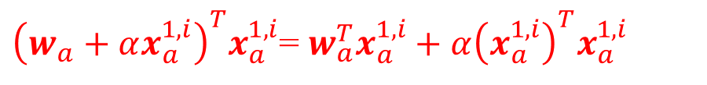
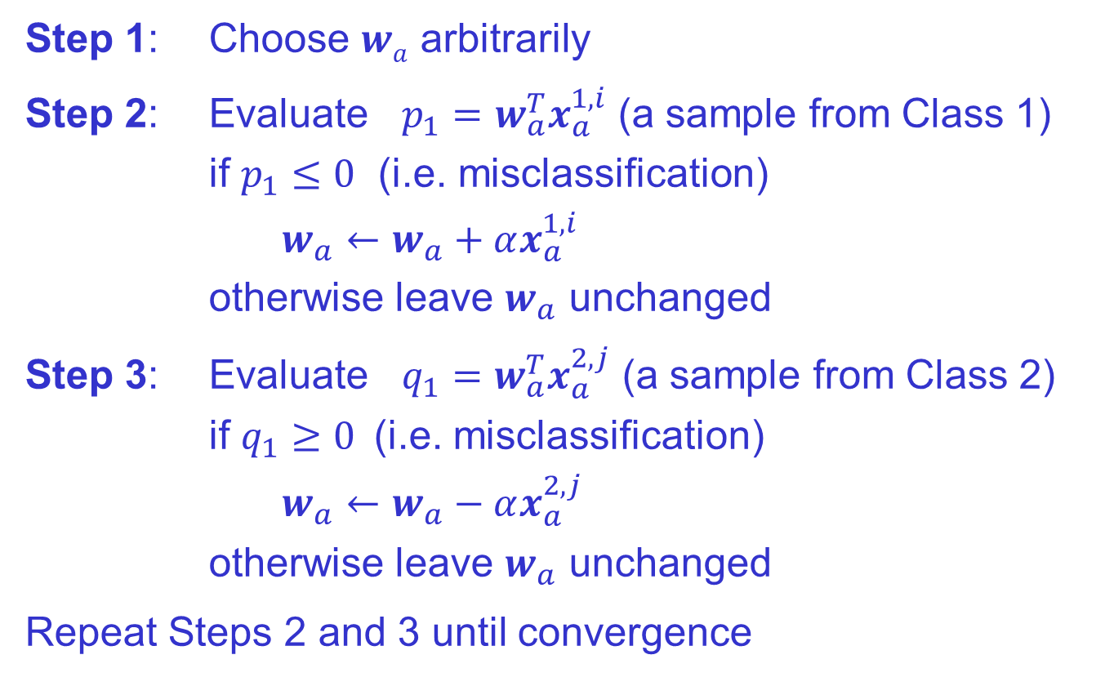

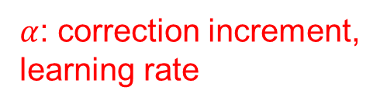
Perceptron Algorithm
${\left(w_{a}+αx_{a}^{1,i}\right)}^{T}x_{a}^{1,i}$= $w_{a}^{T}x_{a}^{1,i}+α{\left(x_{a}^{1,i}\right)}^{T}x_{a}^{1,i}$
Step 1: Choose $wa$ arbitrarily
Step 2: Evaluate $p_{1}=w_{a}^{T}x_{a}^{1,i}$ (a sample from Class 1)
if $p_{1}≤0$ (i.e. misclassification)
$w_{a}←w_{a}+αx_{a}^{1,i}$
otherwise leave $w_{a}$ unchanged
Step 3: Evaluate $q_{1}=w_{a}^{T}x_{a}^{2,j}$ (a sample from Class 2)
if $q_{1}≥0$(i.e. misclassification)
$w_{a}←w_{a}−αx_{a}^{2,j}$
otherwise leave $w_{a}$ unchanged
Repeat Steps 2 and 3 until convergence
+ve
$$\left[\begin{matrix}a & b\end{matrix}\right]\left[\begin{matrix}a \\ b\end{matrix}\right]=a^{2}+b^{2}$$
$α$: correction increment, learning rate

Slide 19
Multilayer Neural Network
1986, Rumelhart, Hinton, and Williams
  Developed new training algorithms for multilayers of perceptron-like units
  Backpropagation (backprop): an effective training method for multilayer networks, as well as for deep neural networks
  Multilayer, fully connected neural networks, whose inputs are pattern vectors
Based on human-engineering techniques, i.e., handcrafted features

Slide 20
Multilayer Neural Network
An artificial neural network is a layered network of artificial neurons
hidden layer
The weights to be trained
input layer
output layer
The input is a handcrafted feature
Neuron =
weighed sum + activation function
12 weights
8 weights

Slide 21
Deep Neural Network
Deep learning is an extension of the neural network
A deep neural network is a multi-layer neural network that contains two or more hidden layers
The backpropagation algorithm experiences three difficulties in the training process of the deep neural network:
  Vanishing gradient
  Overfitting
  Computational load
To solve the vanishing gradient problem, the Rectified Linear Unit (ReLU) function is used as the activation function

Slide 22

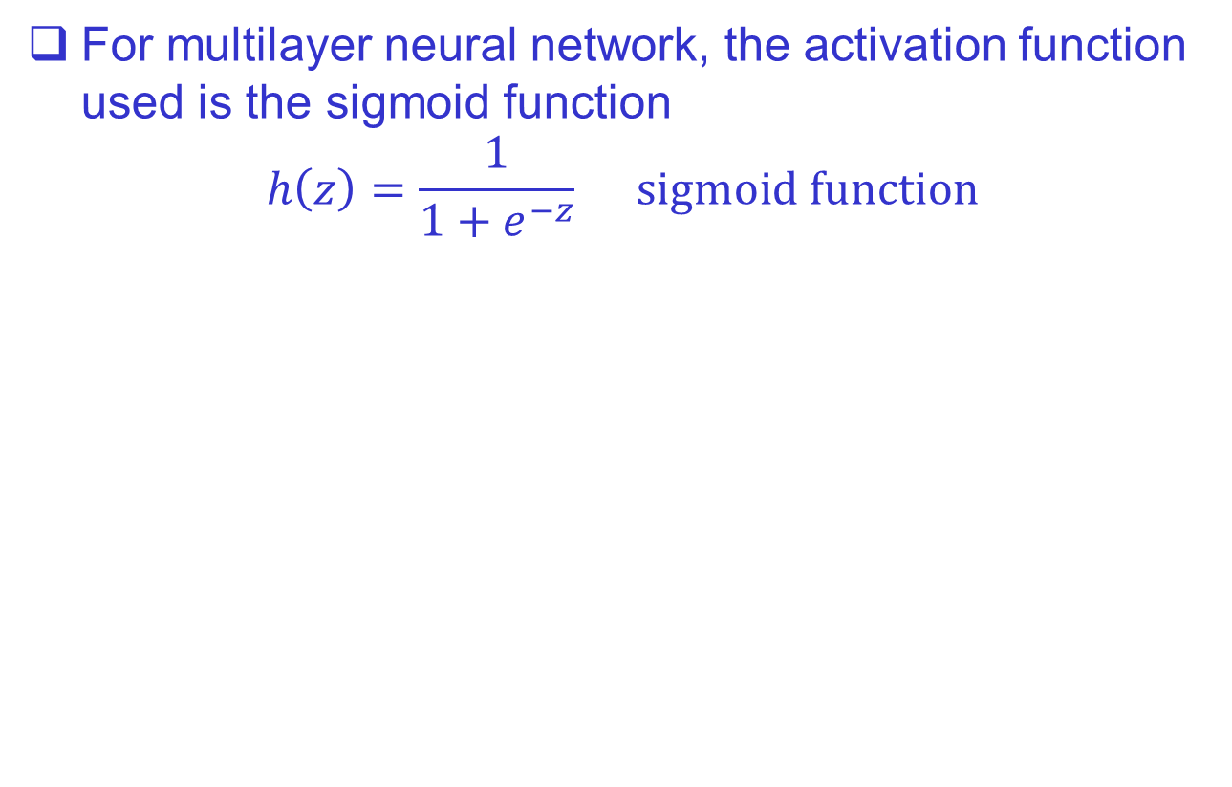
Deep Neural Network
For multilayer neural network, the activation function used is the sigmoid function
$$h\left(z\right)=\frac{1}{1+e^{−z}} sigmoid function$$
Slide 15
1.0
0.5
0
6
4
2
0
ReLU
$$h\left(z\right)=\max{(0,z)}$$
Gradients close to zero
-6 -4 -2 0 2 4 6
-6 -4 -2 0 2 4 6
Sigmoid

Slide 23
Deep Neural Network
Overfitting: the trained network achieved very good performance on training data, but poor performance on test data
Note that the training data set and test data set do not overlap
Various methods have been proposed to solve the overfitting problem (dropout, data augmentation, …)
Computational load is relieved to a considerable extent by the use of mini-batch and the introduction of high-performance hardware, such as Graphics Processing Unit (GPU)

Slide 24

Deep Neural Network
CAR
PERSON
ANIMAL
Output
(object identity)
3rd hidden layer
(object parts)
2nd hidden layer
(corners and contours)
1st hidden layer
(edges)
Visible layer
(input pixels)
Feature extraction and classification are learned simultaneously

Slide 25
Deep Neural Network
Overfitting
  When training a machine learning model, the training error (e.g. MSE_{train}) is minimized
  The generalization error, also called the test error (e.g. MSE_{test}), is to be low as well
    Estimated by measuring the performance on a test set of examples that are collected separately from the training set
  The factors determining how well a learning algorithm will perform are its ability to
    make the training error small
    make the gap between training and test errors small

Slide 26
Deep Neural Network
Underfitting occurs when the model is not able to obtain a sufficiently low error rate on the training set
Overfitting occurs when the gap between the training and test errors is too large
A model can be controlled to be more likely to overfit or underfit by altering its capacity
To train deep neural networks, different techniques have been used to avoid overfitting

Slide 27







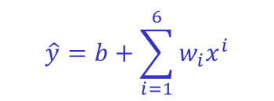
Underfitting
Appropriate capacity
Overfitting
$$y$$
$$y$$
$$y$$
unseen, test data
$$\hat{y}=b+\sum_{i=1}^{6}{w_{i}x^{i}}$$
$$\hat{y}=b+w_{1}x+w_{2}x^{2}$$
training data
$$x$$
$$x$$
$$x$$
linear function quadratic function a polynomial of degree 6
Large training error
Large test error
Small training error
Small test error
Small training error
Large test error
Among the competing hypotheses or learning models that explain known observations equally well, the “simplest” one should be chosen

Slide 28
Deep Neural Network
Convolutional Neural Network (CNN)
A class of deep, feed-forward artificial neural networks
Training images are input directly into CNN, and the network learns the necessary features on its own
Inputting images: the spatial relationships that may exist between pixels in an image can be retained and utilized
Inspired by biological processes: the connectivity pattern between neurons resembles the organization of the animal visual cortex
  Individual cortical neurons respond to stimuli only in a restricted region of the visual field (receptive field)

Slide 29
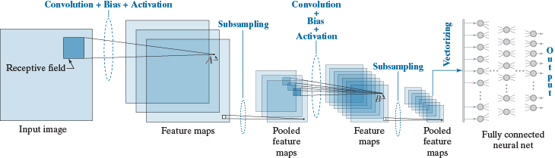
Deep Neural Network
Every input of a layer is fed by a single value, determined by the convolution over a spatial neighborhood (receptive field) in the output of the previous layer
Convolution computes a sum of products between pixels and a set of kernel weights
Convolution + Bias → Activation

Slide 30
Deep Neural Network
feature map of size 10×10
• • • •
• • • •
receptive field: 3×3
image or feature map
size = 12×12

Slide 31
Deep Neural Network
A simple handcrafted feature for edge detection
  Sobel operators (one for horizontal edges and the other for vertical edges)

Slide 32




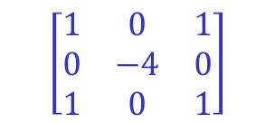
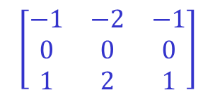
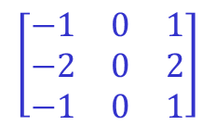
Deep Neural Network
Convolutional Neural Networks
Channel 1
filter 1
The output contains N feature maps, so it has N channels
$$\left[\begin{matrix}−1 & 0 & 1 \\ −2 & 0 & 2 \\ −1 & 0 & 1\end{matrix}\right]$$
Channel 2
filter 2
$$\left[\begin{matrix}−1 & −2 & −1 \\ 0 & 0 & 0 \\ 1 & 2 & 1\end{matrix}\right]$$
Input
• • • •
Channel N
• • • •
Each filter applied to an input through the convolutional operation will produce a feature output
filter N
$$\left[\begin{matrix}1 & 0 & 1 \\ 0 & −4 & 0 \\ 1 & 0 & 1\end{matrix}\right]$$
7

Slide 33
Deep Neural Network
Three different kernels
The receptive field is moved over the image and, at each location, convolution (a sum of products of the kernel weights and the pixels contained in the receptive field) is computed
Each convolution value is added a bias, then passed through an activation function (ReLU)

Slide 34
Deep Neural Network
convolutional layer 2
convolutional layer 1
The result is stored in a feature map – convolution is to extract features such as edges, points, and blobs from the input
A feature map is produced by using the same weights and a single bias (the kernel) – weight (or parameter) sharing
The feature maps are referred to collectively as a convolutional layer

Slide 35
Deep Neural Network
CNN is also called shift-invariant NN
The process after convolution and activation is subsampling, also called pooling
A reduction in spatial resolution can make the features more robust

Slide 36

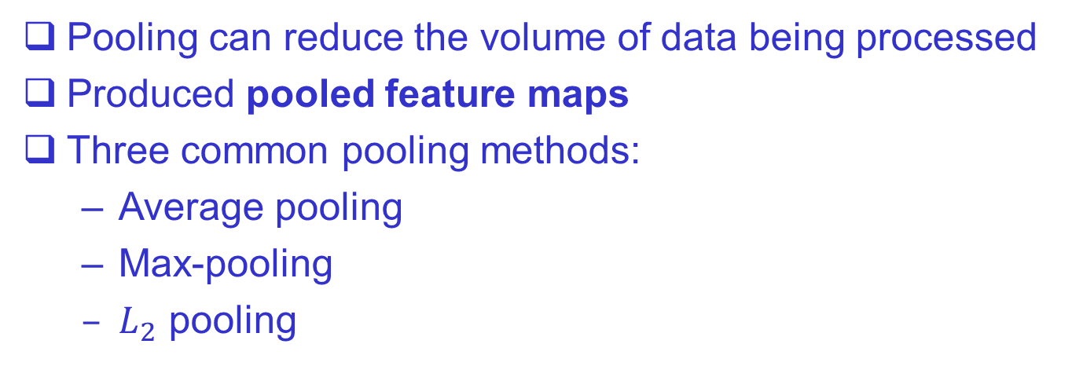
Deep Neural Network
Translation Invariance:
The kernel is slid over the image, so the same object at different locations can be detected
Pooling can reduce the volume of data being processed
Produced pooled feature maps
Three common pooling methods:
  Average pooling
  Max-pooling
  $L_{2}$ pooling

Slide 37

Introduction to DNN
$$𝒜$$
3 | 11
1 | 3
average pooling
1 | 1 | 1 | 30
4 | 6 | 5 | 8
3 | 0 | 1 | 5
0 | 1 | 2 | 4
max pooling
6 | 30
3 | 5
L₂ pooling
7.3 | 31.4
3.2 | 6.8

Slide 38
Deep Neural Network
The pooled feature maps are referred to collectively as a pooling layer
The second convolutional layer has the pooled feature maps as its multiple inputs
For each feature map in the second layer, a different kernel (weights + bias) is applied to a pooled feature map in the previous layer to generate a value

Slide 39
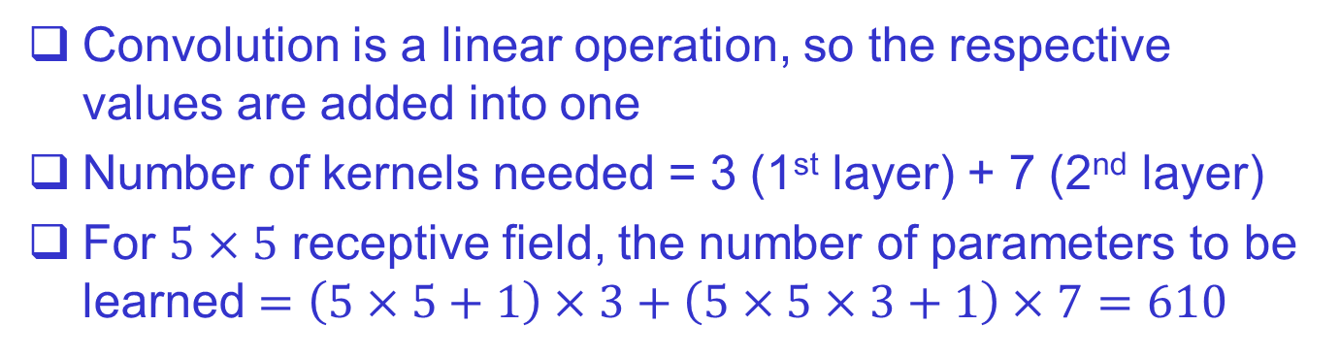
Deep Neural Network
3 different kernels
3 pooled feature maps to produce 7 feature maps
Convolution is a linear operation, so the respective values are added into one
Number of kernels needed = 3 (1st layer) + 7 (2nd layer)
For $5×5$ receptive field, the number of parameters to be learned $=\left(5×5+1\right)×3+\left(5×5×3+1\right)×7=610$

Slide 40

Deep Neural Network
feature map
n×n×m
m
n×n
The 2-D pooled feature maps in the last layer are vectorized to form a column vector, which is fed into a fully connected neural net
The number of outputs in the fully connected net is equal to the number of pattern classes being classified
The output with the highest value determines the class of the input

Slide 41
END & Thank you

Slide 42



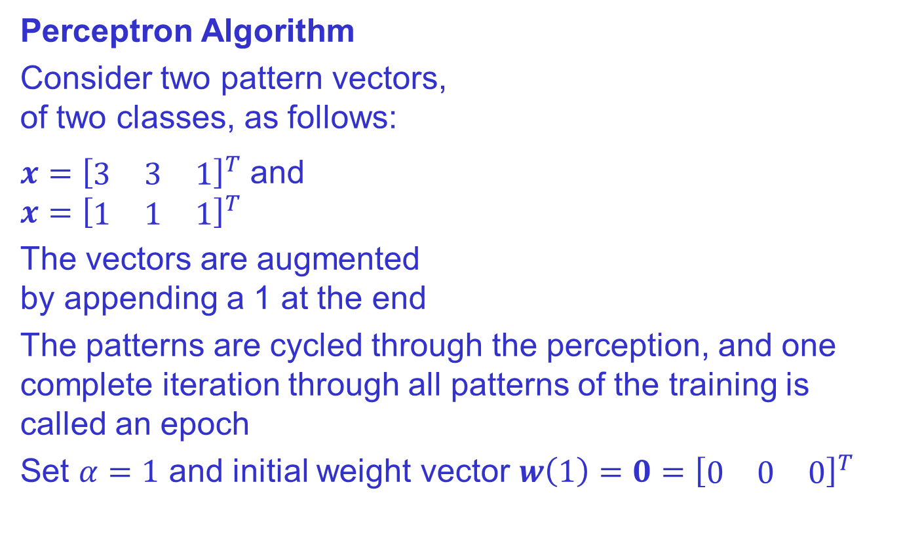



Example 1
$$x_{2}$$
$$x=\left(3,3\right)∈Class1$$
Perceptron Algorithm
Consider two pattern vectors,
of two classes, as follows:
$x={\left[\begin{matrix}3 & 3 & 1\end{matrix}\right]}^{T}$ and
$$x={\left[\begin{matrix}1 & 1 & 1\end{matrix}\right]}^{T}$$
The vectors are augmented
by appending a 1 at the end
The patterns are cycled through the perception, and one complete iteration through all patterns of the training is called an epoch
Set $α=1$ and initial weight vector $w\left(1\right)=0={\left[\begin{matrix}0 & 0 & 0\end{matrix}\right]}^{T}$
$$w={\left[\begin{matrix}w_{1} & w_{2} & b\end{matrix}\right]}^{T}$$
$$x=\left(1,1\right)∈Class2$$
$$\left(0,0\right)$$
$$x_{1}$$

Slide 43
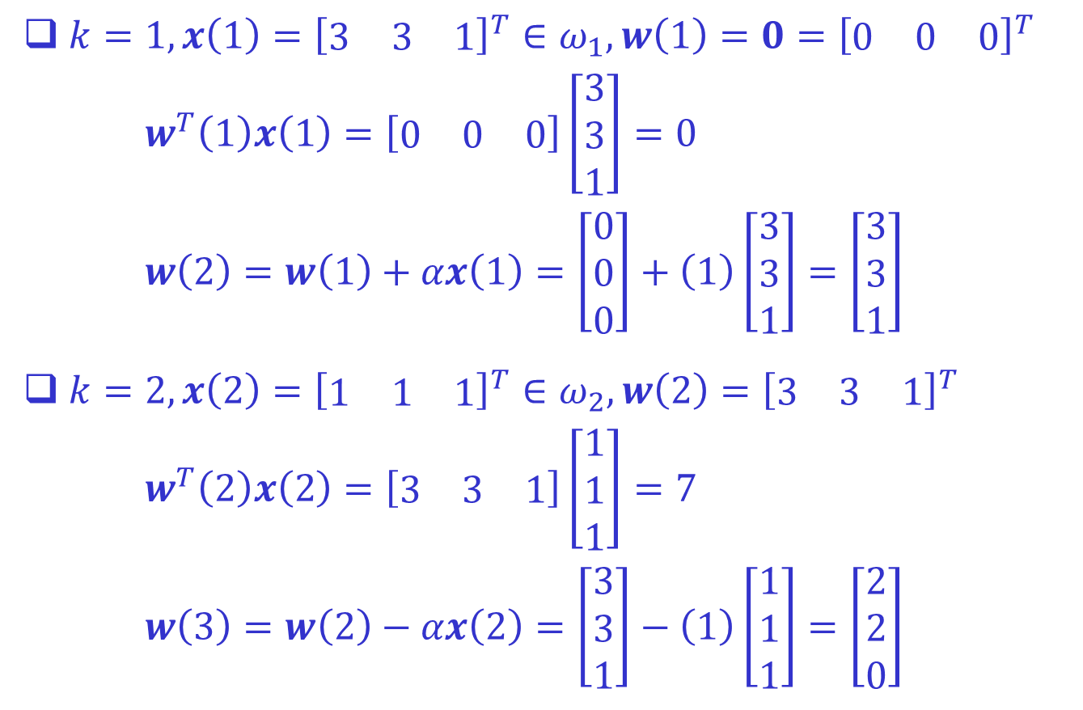
$k=1, x\left(1\right)={\left[\begin{matrix}3 & 3 & 1\end{matrix}\right]}^{T}∈ω_{1}, w\left(1\right)=0={\left[\begin{matrix}0 & 0 & 0\end{matrix}\right]}^{T}$
$$w^{T}\left(1\right)x\left(1\right)=\left[\begin{matrix}0 & 0 & 0\end{matrix}\right]\left[\begin{matrix}3 \\ 3 \\ 1\end{matrix}\right]=0$$
$$w\left(2\right)=w\left(1\right)+αx\left(1\right)=\left[\begin{matrix}0 \\ 0 \\ 0\end{matrix}\right]+\left(1\right)\left[\begin{matrix}3 \\ 3 \\ 1\end{matrix}\right]=\left[\begin{matrix}3 \\ 3 \\ 1\end{matrix}\right]$$
$k=2, x\left(2\right)={\left[\begin{matrix}1 & 1 & 1\end{matrix}\right]}^{T}∈ω_{2}, w\left(2\right)={\left[\begin{matrix}3 & 3 & 1\end{matrix}\right]}^{T}$
$$w^{T}\left(2\right)x\left(2\right)=\left[\begin{matrix}3 & 3 & 1\end{matrix}\right]\left[\begin{matrix}1 \\ 1 \\ 1\end{matrix}\right]=7$$
$$w\left(3\right)=w\left(2\right)−αx\left(2\right)=\left[\begin{matrix}3 \\ 3 \\ 1\end{matrix}\right]−\left(1\right)\left[\begin{matrix}1 \\ 1 \\ 1\end{matrix}\right]=\left[\begin{matrix}2 \\ 2 \\ 0\end{matrix}\right]$$

Slide 44
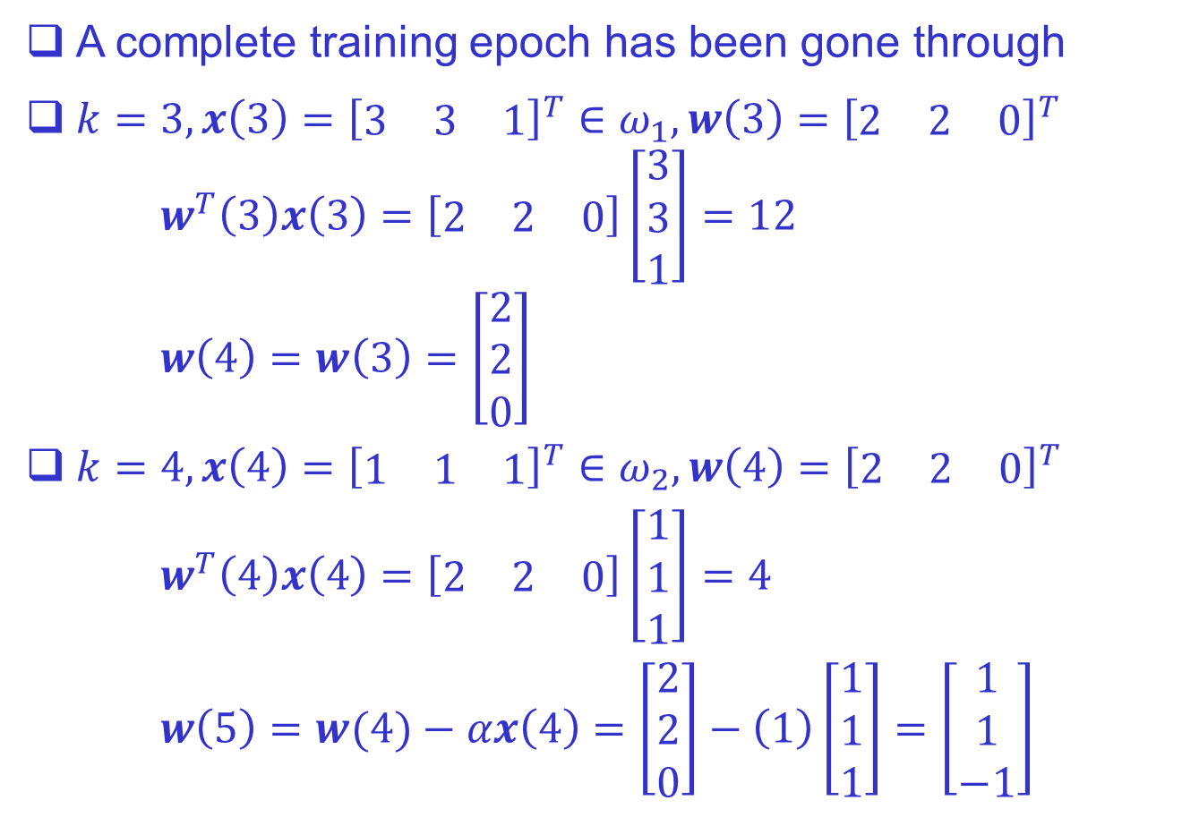
A complete training epoch has been gone through
$k=3, x\left(3\right)={\left[\begin{matrix}3 & 3 & 1\end{matrix}\right]}^{T}∈ω_{1}, w\left(3\right)={\left[\begin{matrix}2 & 2 & 0\end{matrix}\right]}^{T}$
$$w^{T}\left(3\right)x\left(3\right)=\left[\begin{matrix}2 & 2 & 0\end{matrix}\right]\left[\begin{matrix}3 \\ 3 \\ 1\end{matrix}\right]=12$$
$$w\left(4\right)=w\left(3\right)=\left[\begin{matrix}2 \\ 2 \\ 0\end{matrix}\right]$$
$k=4, x\left(4\right)={\left[\begin{matrix}1 & 1 & 1\end{matrix}\right]}^{T}∈ω_{2}, w\left(4\right)={\left[\begin{matrix}2 & 2 & 0\end{matrix}\right]}^{T}$
$$w^{T}\left(4\right)x\left(4\right)=\left[\begin{matrix}2 & 2 & 0\end{matrix}\right]\left[\begin{matrix}1 \\ 1 \\ 1\end{matrix}\right]=4$$
$$w\left(5\right)=w(4)−αx\left(4\right)=\left[\begin{matrix}2 \\ 2 \\ 0\end{matrix}\right]−\left(1\right)\left[\begin{matrix}1 \\ 1 \\ 1\end{matrix}\right]=\left[\begin{matrix}1 \\ 1 \\ −1\end{matrix}\right]$$

Slide 45
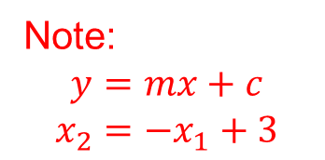


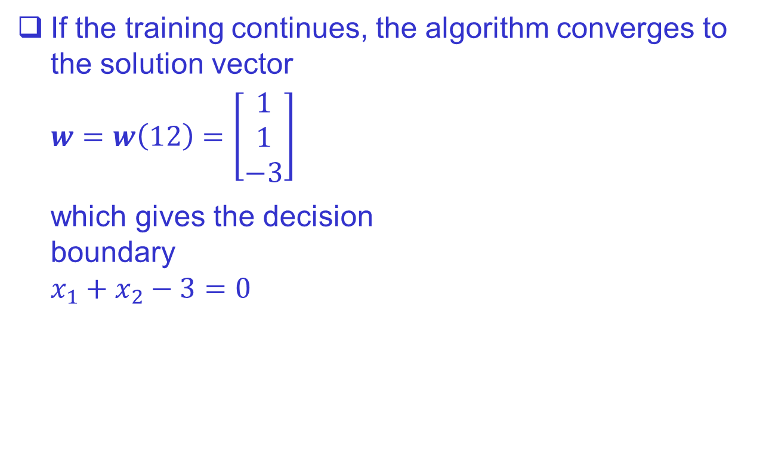



If the training continues, the algorithm converges to the solution vector
$$w=w\left(12\right)=\left[\begin{matrix}1 \\ 1 \\ −3\end{matrix}\right]$$
which gives the decision
boundary
$$x_{1}+x_{2}−3=0$$
$$x_{2}$$
$$x=\left(3,3\right)∈Class1$$
Note:
$$y=mx+c$$
$$x_{2}=−x_{1}+3$$
$$x=\left(1,1\right)∈Class2$$
$$\left(0,0\right)$$
$$x_{1}$$

Slide 46




Example 2
A three-layer neural network
The network consists of the input layer, one hidden
layer, and the output layer
The network accepts three inputs and has two outputs
$$x_{1}$$
3 weights 1 bias
$$(L=3, n_{L}=2)$$
0.1
0.2
0.2
Input:
3-D feature vector
$$x_{2}$$
0.6
0.4
0.1
0.6
Output:
Two classes
0.4
0.1
0.3
0.4
$$x_{3}$$
0.1
2 weights 1 bias
0.2
0.3
Total number of parameters to be trained = $\left(3+1\right)×2+\left(2+1\right)×2=14$

Slide 47

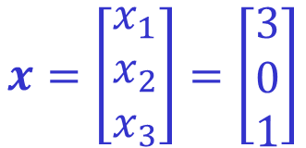

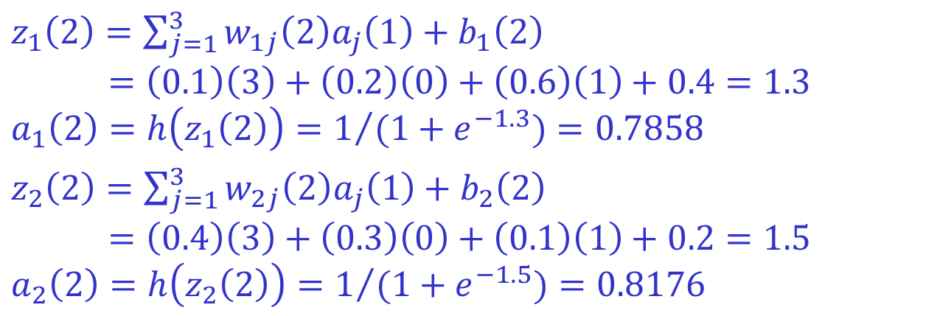



$$x_{1}$$
3
0.1
$$0.7858$$
0.2
0.2
$$x=\left[\begin{matrix}x_{1} \\ x_{2} \\ x_{3}\end{matrix}\right]=\left[\begin{matrix}3 \\ 0 \\ 1\end{matrix}\right]$$
0
$$x_{2}$$
0.6
0.4
0.1
0.6
0.4
0.1
0.3
0.4
1
0.1
$$0.8176$$
$$x_{3}$$
0.2
0.3
$z_{1}\left(2\right)=\sum_{j=1}^{3}{w_{1j}\left(2\right)a_{j}\left(1\right)}+b_{1}\left(2\right)$
$$=\left(0.1\right)\left(3\right)+\left(0.2\right)\left(0\right)+\left(0.6\right)\left(1\right)+0.4=1.3$$
$$a_{1}\left(2\right)=h\left(z_{1}\left(2\right)\right)=1/{(1+e^{−1.3})}=0.7858$$
$z_{2}\left(2\right)=\sum_{j=1}^{3}{w_{2j}\left(2\right)a_{j}\left(1\right)}+b_{2}\left(2\right)$
$$=\left(0.4\right)\left(3\right)+\left(0.3\right)\left(0\right)+\left(0.1\right)\left(1\right)+0.2=1.5$$
$$a_{2}\left(2\right)=h\left(z_{2}\left(2\right)\right)=1/{(1+e^{−1.5})}=0.8176$$

Slide 48


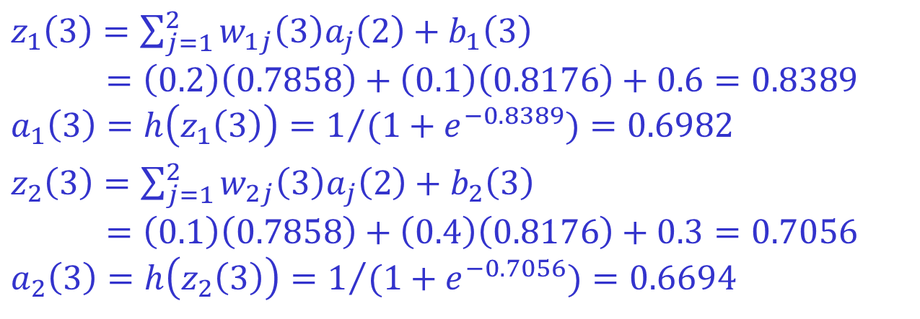

$$x_{1}$$
3
0.1
$$0.7858$$
$$0.6982$$
0.2
0.2
$$x=\left[\begin{matrix}x_{1} \\ x_{2} \\ x_{3}\end{matrix}\right]=\left[\begin{matrix}3 \\ 0 \\ 1\end{matrix}\right]$$
0
$$x_{2}$$
0.6
0.4
0.1
0.6
0.4
0.1
0.3
$$0.6694$$
1
0.4
0.1
$$0.8176$$
$$x_{3}$$
0.2
0.3
$z_{1}\left(3\right)=\sum_{j=1}^{2}{w_{1j}\left(3\right)a_{j}\left(2\right)}+b_{1}\left(3\right)$
$$=\left(0.2\right)\left(0.7858\right)+\left(0.1\right)\left(0.8176\right)+0.6=0.8389$$
$$a_{1}\left(3\right)=h\left(z_{1}\left(3\right)\right)=1/{(1+e^{−0.8389})}=0.6982$$
$z_{2}\left(3\right)=\sum_{j=1}^{2}{w_{2j}\left(3\right)a_{j}\left(2\right)}+b_{2}\left(3\right)$
$$=\left(0.1\right)\left(0.7858\right)+\left(0.4\right)\left(0.8176\right)+0.3=0.7056$$
$$a_{2}\left(3\right)=h\left(z_{2}\left(3\right)\right)=1/{(1+e^{−0.7056})}=0.6694$$

Slide 49
References
Youtube:
Learning from Data:
https://youtube.com/playlist?list=PLnIDYuXHkit4LcWjDe0EwlE57WiGlBs08&si=M2ufojezUWtgdhns
Introduction to Deep Learning:
https://youtu.be/ErnWZxJovaM?si=ff9pKz4HGxIUx6tE
Books:
Learning from Data - A short course:
https://openeclass.panteion.gr/modules/document/file.php/PMS152/LEARNING/Abu-Mostafa%20Yaser%20S.%2C%20Malik%20Magdon-Ismail%2C%20Hsuan-Tien%20Lin%20%282012%29%20--%20Learning%20From%20Data_%20A%20short%20course.pdf
The Little Book of Deep Learning: https://fleuret.org/public/lbdl.pdf
Dive into Deep Learning: https://vi.d2l.ai/

